Slide 1
ABSTRACT WRITING
Dr. Samson Udho (CNM, PhD)
Facilitator

Slide 2
Learning Objectives
Learners should be able to:
Different types of abstract
Components of an abstract
Contents within each component

Slide 3
Introduction

Slide 4
What is an Abstract?
A brief summary of a research paper, thesis, or report.
Provides an overview of the main points.
Helps readers quickly determine relevance.

Slide 5
Types of Abstract
Structured Abstract
Uses specific subheadings (e.g., Background, Methods, Results, Conclusion).
Common in medical and scientific research.
Unstructured Abstract
No sub-headings.
Common in humanity scientific research.

Slide 6
Components of an Abstract (1)
Background/Purpose
State the problem.
State the gap in literature.
State the aim of study.

Slide 7
Components of an Abstract (2)
Methods
Study design
Study population
Sample size
Sampling technique
Study area
Data collection (method, and tools)
Data analysis

Slide 8
Components of an Abstract (3)
Results
Summarize age and or sex (socio-demographics).
Summarize key findings (starting with outcome variable, followed by independent variable).

Slide 9
Components of an Abstract (4)
Conclusion
Highlights main takeaways (based on study aim)
State the implications, or recommendations.

Slide 10
Tips for Writing an Effective Abstract
Keep it concise (150–300 words)
Use clear, precise language.
Avoid unnecessary details.
Write in the past tense (for completed research).
Follow journal or conference guidelines.

Slide 11
Common Mistakes to Avoid
Being too vague or too detailed.
Including references or citations.
Using jargon without explanation.
Repeating content across sections.

Slide 12
Examples
https://onlinelibrary.wiley.com/doi/abs/10.1155/2022/8231564
https://www.ajol.info/index.php/sajcn/article/view/260554
https://www.frontiersin.org/journals/public-health/articles/10.3389/fpubh.2022.1030914/full

Slide 13
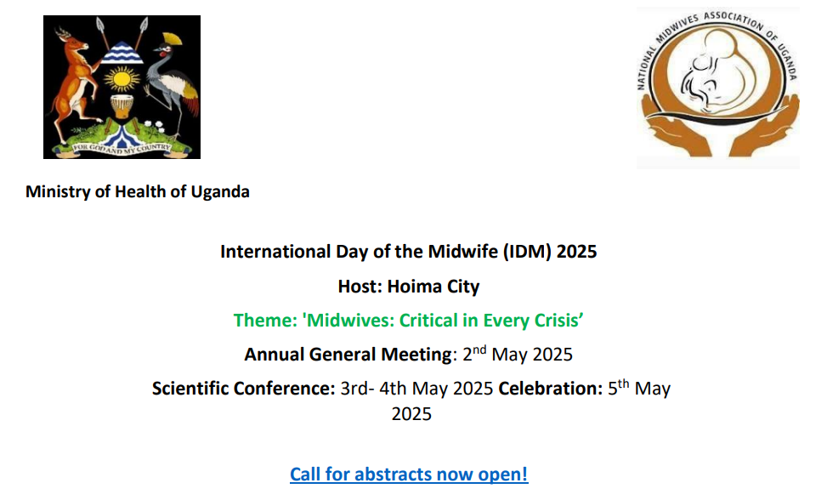
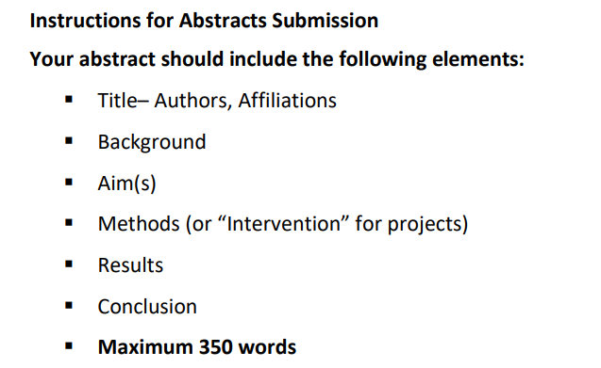
Activity
Write an abstract for the coming IDM, 2025.

Slide 14
Thank you

